Slide 1
Paper unprinting technology
Department : Electrical and electronic engineering
Year : final year sem : 8th
College name : government college of engineering-thanjavur

Slide 2

content
Abstract
Objective
Introduction
Definition
Existing methodology
Proposed methodology
Block diagram
Hardware requirement
Design of machine
Working principle
Application
Conclusion

Slide 3
abstract
Deforestation can be reduce by recycling the printed paper. The innovative technology for the future generation is “paper unprinting technology”.
this technology uses the pulse of light to remove toner , environmental friendly than the conventional paper recycling method .
In this new topology we can reuse the unprinted paper upto five times without affecting the paper coating .
the xenon lamps are used .

Slide 4
objective
The objective of paper is to design the “paper unprinting system”.
This system should be easy to access, pollution free , efficiency is high , less in cost .
To reduce deforestation .
One of the best way for recycling of paper .

Slide 5
introduction
The technology is introduced in the year of 2019 by , Rutgers university, assistant professor, rajiv Malhotra .
Team has created a new way to unprint paper that , unlike laser it can work with a standard coated paper in home and office printers .
The new methods uses a pulse of light from a xenon lamp, and erase black , blue , red and green toner without damaging the paper .

Slide 6
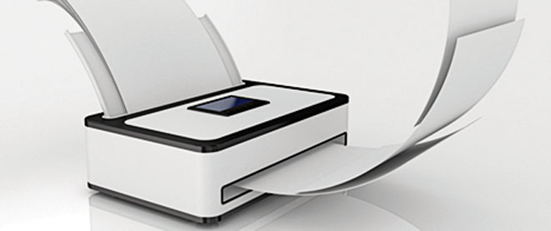
Definition
Paper unprinting technology:
this is the method of unprint the printed paper with the help of the xenon lamp , small amount of benign alcohol .
The process of unprinting the printed paper is known as paper unprinting technology.
This technology can also be done with the help of lasers .

Slide 7
Existing methodology
The existing methodology is by using laser.
Laser are used to remove printer toner from standard copy paper.
It damage the polymer coating found on the fancier glossier paper use for packaging ,advertising and many other application
We conclude such paper is renderd unfit for reuse

Slide 8
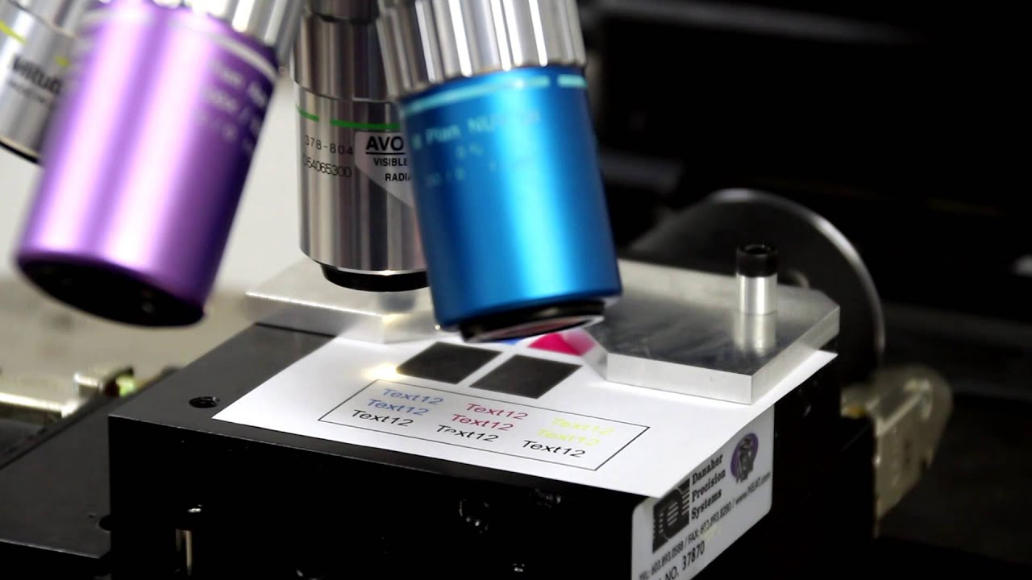
disadvantage
High cost
Damage the paper coating
Lots of power
Incorporate toxic chemicals

Slide 9
Proposed technology
The proposed technology is by using xenon lamp .
This method uses a xenon lamp to blast the printed paper with intense pulse light , a technology often used in cosmetic practices such as hair removal.
Our method make it possible to unprint and then reprint on the same paper at least five times.
It can erase black , blue , red and green toners.

Slide 10
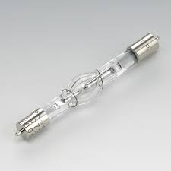
advantage
Reduce cost.
Free from pollution.
Reduce the Greenhouse gas emission.
Reduce in deforestation.

Slide 11


Reduce in deforestation
after
CUTTING OF 3 TREES
CUTTING OF 1 TREE

Slide 12
Block diagram
Intense Pulsed Light IPL
Printed paper
Xenon lamp
Unprinted paper
Ethanol wipes

Slide 13
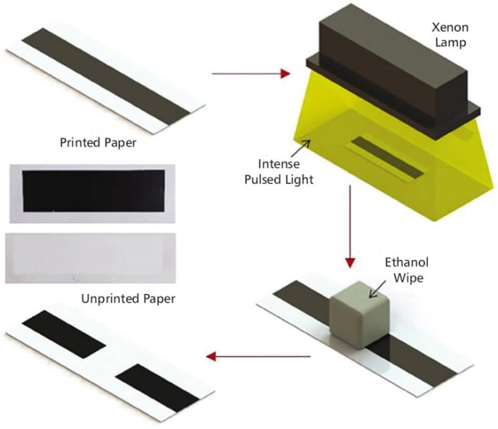
Block diagram

Slide 14
Hardware Requirement
Xenon lamp
Ethanol wipes

Slide 15
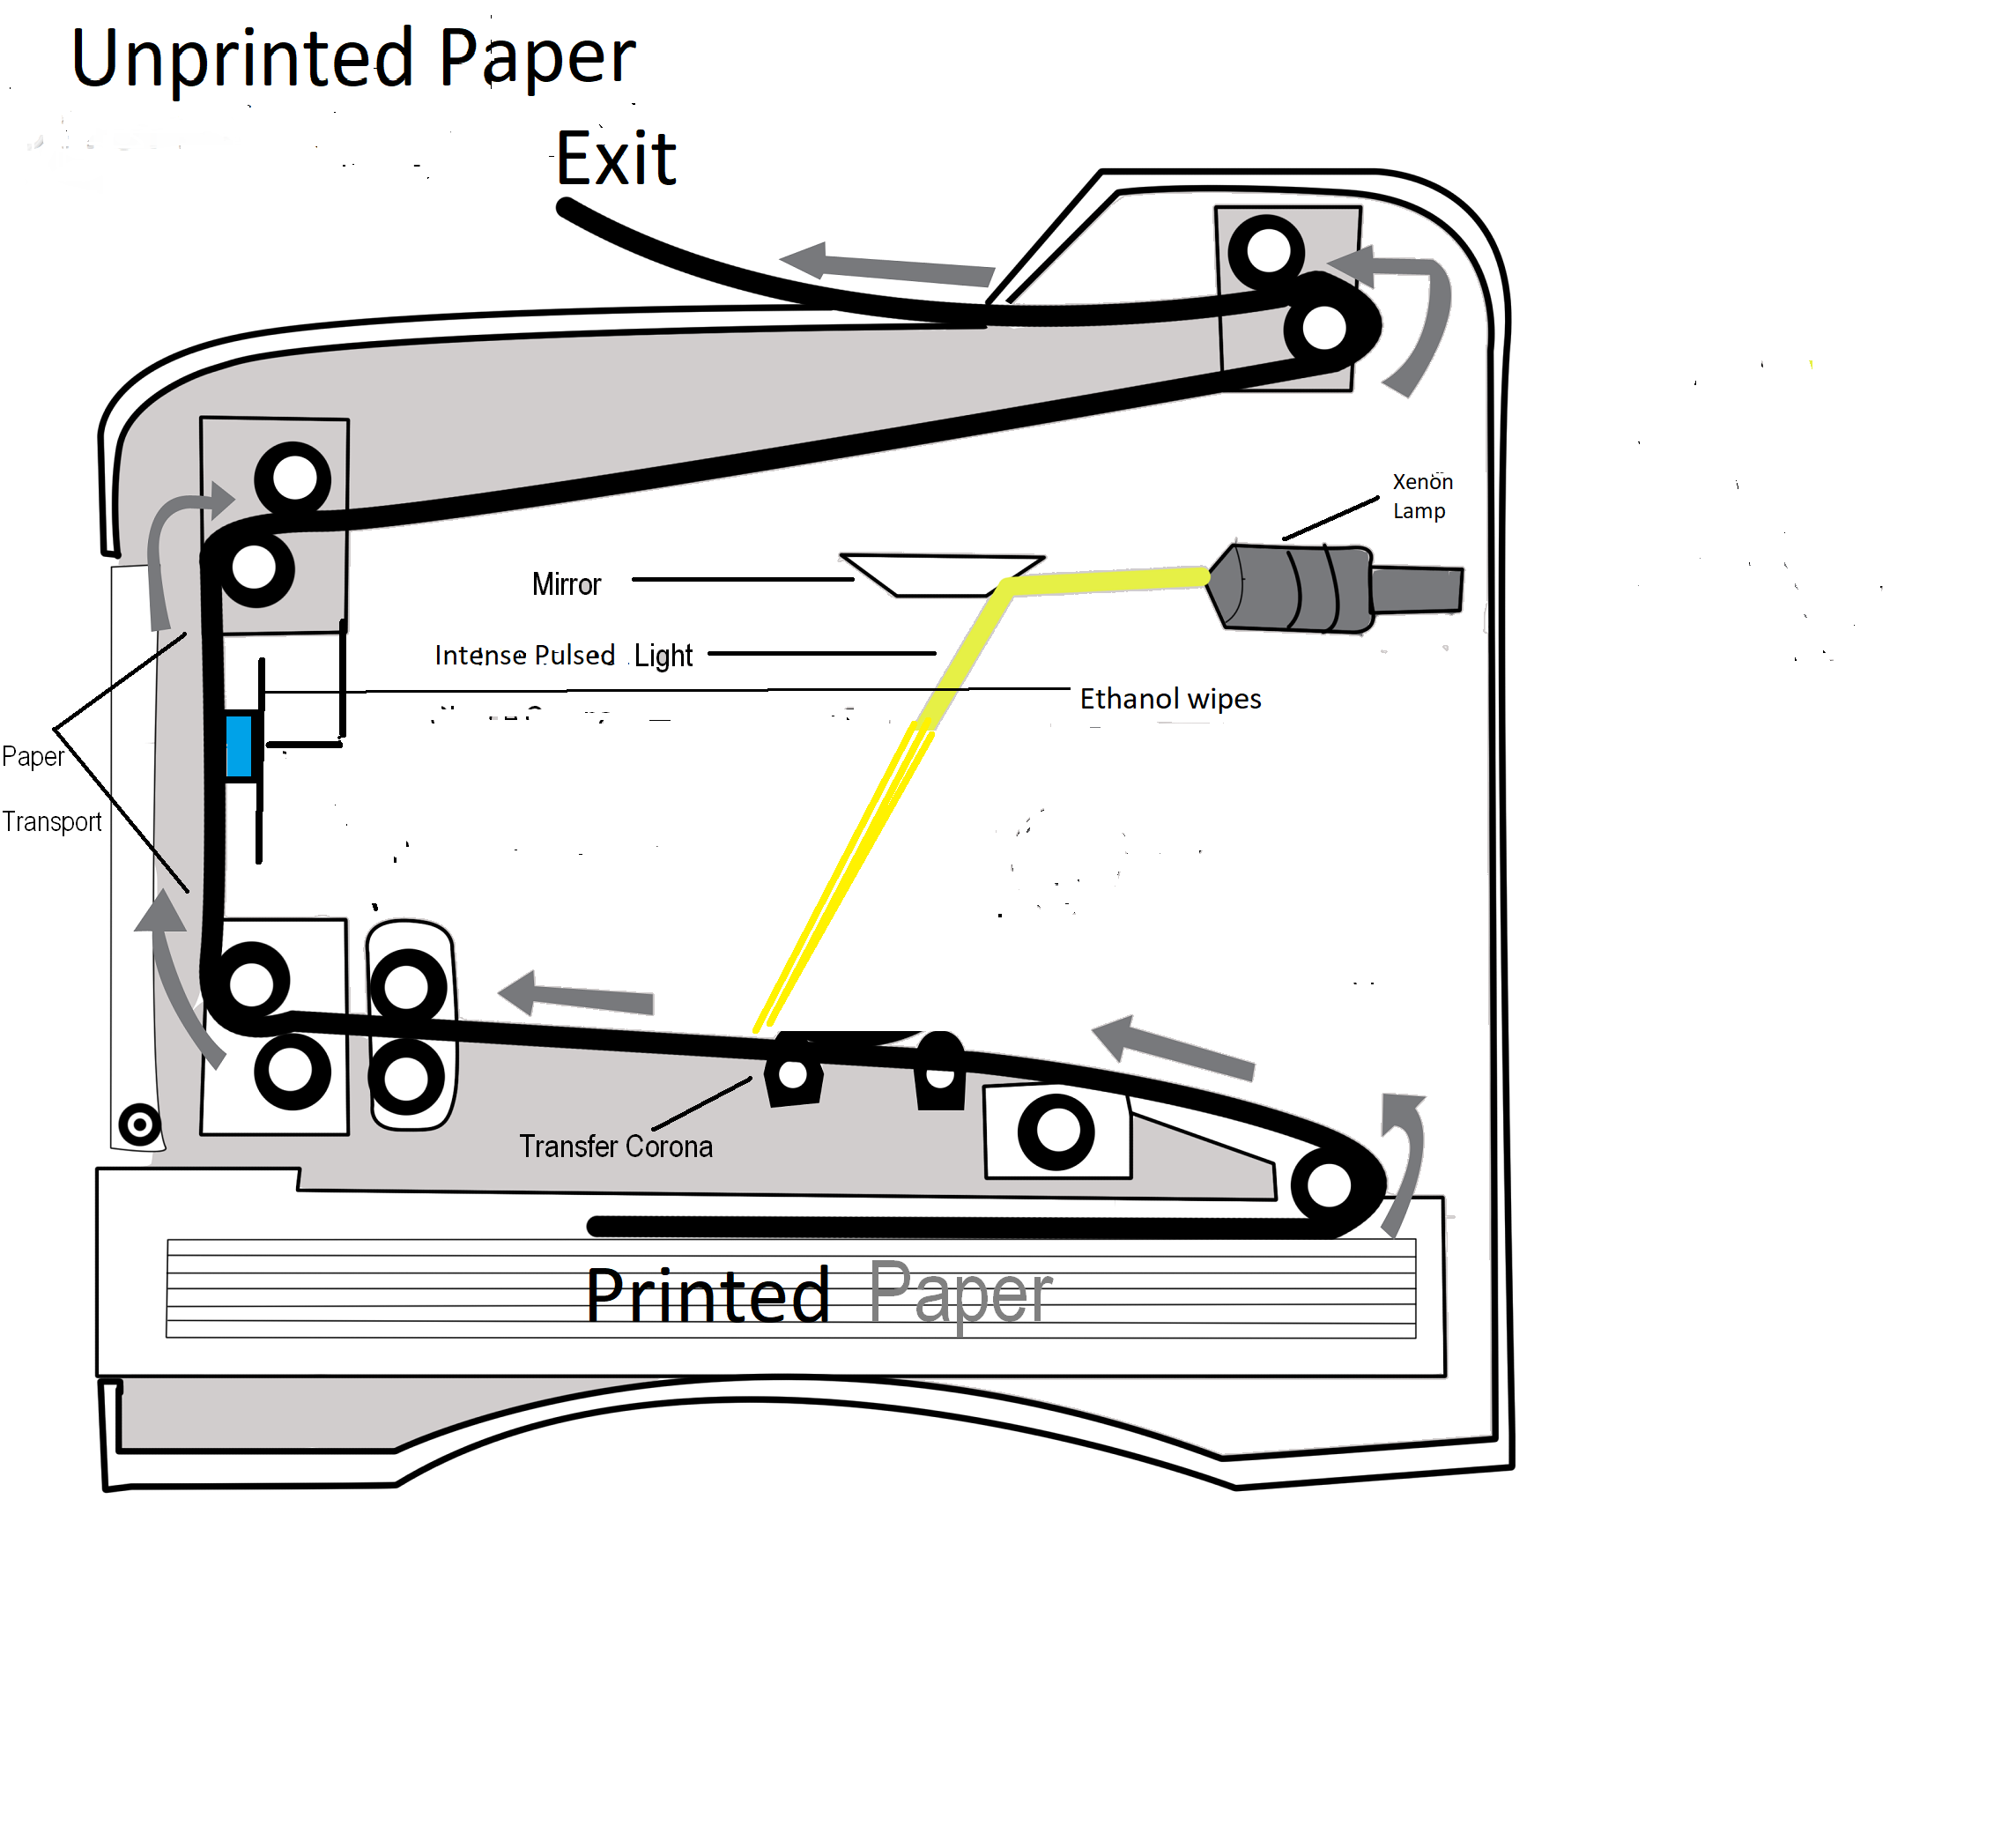
Design of machine

Slide 16
working
The paper in the lower tray is transfer up by using the paper transport system
Xenon lamp is operate with plasma generator.
Xenon lamp emits the intense pulse light IPL .

Slide 17
The toner get weakened by the IPL .
The weakened toner move to the ethanol wipes .
The ethanol wipes containing isopropyl alcohol .
To remove black toner .
The unprinted paper is exited .

Slide 18
Application
home
office
Software companies
Education oriented

Slide 19
Conclusion
We are conclude that , the printed paper can be easily unprinted and reprint again and again without damaging the paper.
Reusing the paper will save 50-80 percentage of carbon emission .
This is afortable method for carbon emission .

Slide 20
Thank you

